Slide 1

Indian Agriculture Analysis
Presented by Rohit Kumar Gupta(23MCA20401)
Rajiv Kumar(23MCA20411)
Abhay(23MCA20448)

Slide 2

Problem Statement
This project analyzes Indian agriculture using district-wise and year-wise data. The dataset includes detailed information on crop areas, production, and yields across different districts and years. Our goal is to use Power BI for interactive visualizations that uncover trends and disparities in agricultural practices. This analysis helps stakeholders in making informed decisions for sustainable farming and resource allocation.

Slide 3
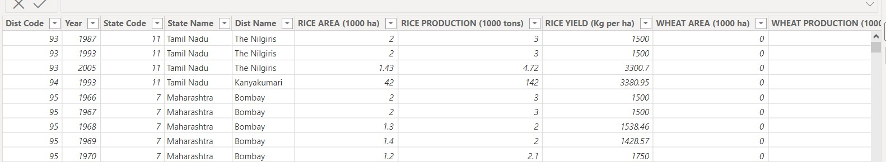
Dataset Overview
Area: The land area used for cultivating a crop measured in thousand hectares (ha).
Production: The quantity of crop harvested from the cultivated area measured in thousand tons.
Yield: The efficiency of crop production, representing the amount of crop harvested per unit area of land typically measured in kilograms per hectare (Kg/ha).

Slide 4
INSIGHTS
Data Exploration
Major Crop Analysis
State Analysis
Fruits and Vegetables
Analysis
Seasonal Analysis

Slide 5



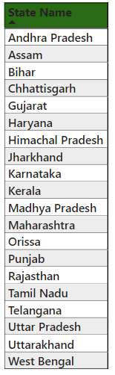
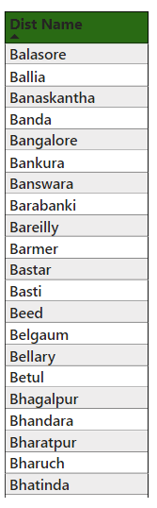
Data Explorations
The dataset consists of 1617 rows and 80 columns, covering information from 20 states and 311 districts.
The dataset spans from 1966 to 2017, providing a total of 52
years of data.
There are 29 crop columns in the dataset, including:
Rice, Wheat, Kharif Sorghum, Rabi Sorghum, Sorghum, Pearl Millet, Maize, Finger Millet, Barley, Chickpea, Pigeonpea, Minor Pulses, Groundnut, Sesamum, Rapeseed and Mustard, Safflower, Castor, Linseed, Sunflower, Soybean, Oilseeds, Sugarcane, Cotton, Fruits, Vegetables, Fruits and Vegetables, Potatoes, Onion, Fodder.

Slide 6



Major Crops Analysis
Analyzing the trends in the cultivation of major crops, including rice, wheat, and pulses, focusing on changes in area, production, and yield.

Slide 7
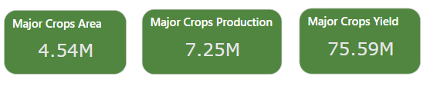
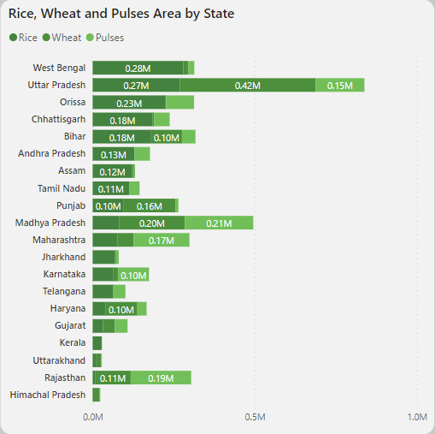
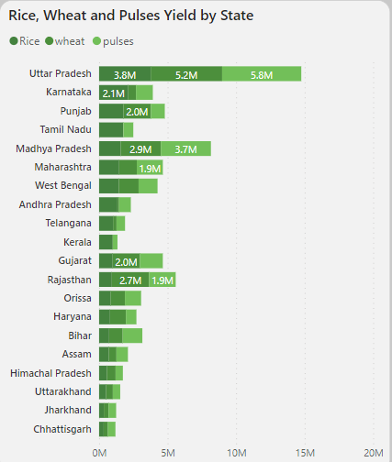
Major Crops Analysis
The 4.54 million hectares allocated to major crops, with a production output of 7.25 million tons, signify a strong agricultural output and positive growth trends.
Major Crop Area:
Uttar Pradesh, Madhya Pradesh, Bihar show significant cultivation areas for rice, wheat, and pulses, indicating their dominance in crop production. Conversely, Himachal Pradesh, Uttarakhand, and Kerala have smaller cultivation areas, suggesting potential areas for agricultural expansion.
Major Crops Yield:
Regarding crop yield, Uttar Pradesh, Madhya Pradesh, and Rajasthan demonstrate higher yields, reflecting effective farming practices or favorable conditions, while Chattisgarh exhibits lower yields, possibly indicating areas for improvement in agricultural productivity.

Slide 8
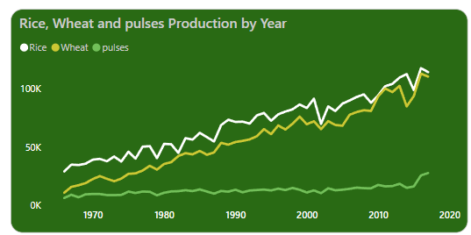
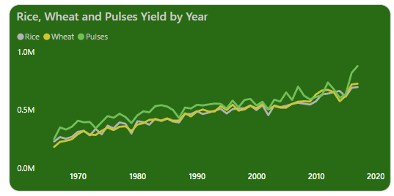
Major Crops Analysis
Production Trend:
The production trends highlight a significant rise in Rice production over the years, with wheat also showing consistent growth, whereas pulses demonstrate relatively lower and stable production levels, with a minor increase observed in 2020.
Yield Trend:
The yield trends suggest variations among the crops, with pulses generally exhibiting higher yields compared to wheat and rice, implying potential differences in crop management or environmental factors affecting yield outcomes.
Why is pulses production low but yield high?
Even though pulses have low production, their high yield indicates efficient farming methods. This suggests that farmers are getting more output per unit of land, possibly due to effective agricultural practices.

Slide 9

State Analysis
Examining agricultural trends at the state level provides valuable insights into regional crop patterns and productivity, guiding targeted decision-making for each state's agricultural sector.

Slide 10
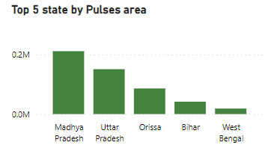
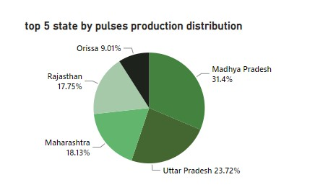
State Analysis
Pulses Area:
The top five states by pulses area are Madhya Pradesh, Uttar Pradesh, Orissa, Bihar, and West Bengal. Among these, Madhya Pradesh has the largest area dedicated to pulses cultivation.
Pulses Production:
In terms of production, Madhya Pradesh leads with 31%, followed by Uttar Pradesh at 23%, Maharashtra at 18%, Rajasthan at 17%, and Orissa at 9%. This shows significant differences in pulses cultivation and production across states.
Why does Orissa rank high in pulses cultivation area but last in
production?
The difference might be due to lower yields, inefficient farming, unfavorable weather, or post-harvest challenges.

Slide 11
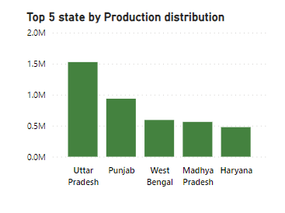
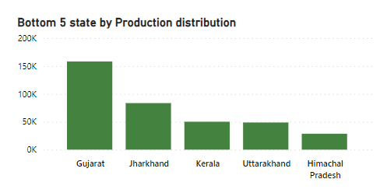
State Analysis
Top 5 states in production:
Uttar Pradesh, Punjab, West Bengal, Madhya Pradesh, and Haryana, are major contributors to agricultural production, highlighting their importance in the agricultural sector.
Bottom 5 states :
Himachal Pradesh, Uttarakhand, Kerala, Jharkhand, and Gujarat - indicate room for improvement in agricultural productivity.

Slide 12


Seasonal Analysis
Exploring seasonal patterns in crop cultivation, considering kharif and rabi seasons.
Kharif Crop Season:
Sown during the rainy season, from June to September.
Harvested in the late autumn or early winter.
Examples: rice, maize, millet etc.
Rabi Crop Season:
Sown in the winter season, from October to March.
Harvested in late spring or early summer.
Examples: wheat, barley, and pulses.

Slide 13
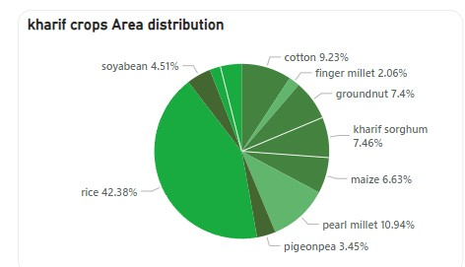
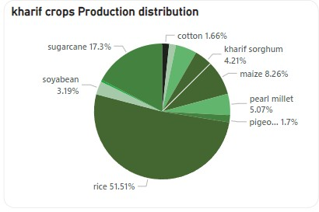
Seasonal Analysis
Kharif crop Area & Production Distribution:
In the Kharif crop season, rice cultivation occupies the largest area and accounts for the highest production levels, highlighting its crucial role in agriculture.
The high production levels of rice and sugarcane indicates their economic value, while the comparatively lower production levels of sesame, finger millet, and cotton suggest potential challenges or lower demand for these crops. This comparison offers insights into the diverse dynamics within the Kharif crop season.

Slide 14
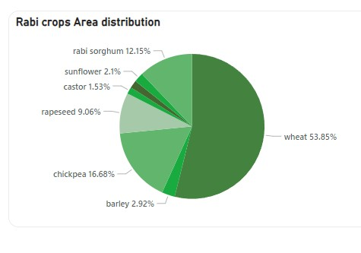
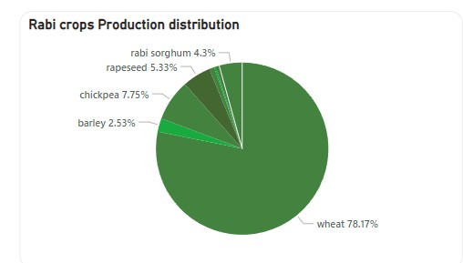
Seasonal Analysis
Rabi crop Area & Production Distribution:
In the Rabi crop season, Wheat dominates with approximately 78% of the total area and contributes 53% to the overall production, emphasizing its significance in Rabi agriculture.
Following wheat, chickpeas account for 7% of the area
and 16% of the production.
However, crops like linseed, castor, and sunflower occupy minimal space and production, indicating their lesser importance or cultivation challenges.

Slide 15
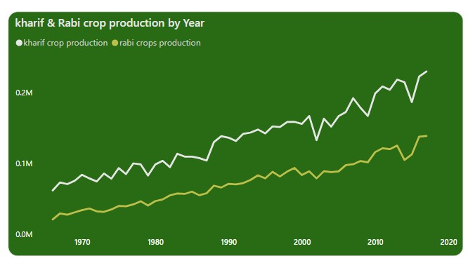
Seasonal Analysis
Production Trend of Kharif & Rabi Crop :
Kharif crop production consistently exceeds Rabi crop production each year.
This suggests the significant contribution of Kharif crops to overall agricultural output compared to Rabi crops.
The upward trend in both productions indicates improvements in farming practices or favorable conditions leading to higher yields annually.

Slide 16
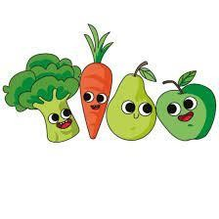

Fruits & Vegetables Analysis
Analyzing the cultivation trends of fruits, vegetables, and their overall contribution to agricultural practices.

Slide 17
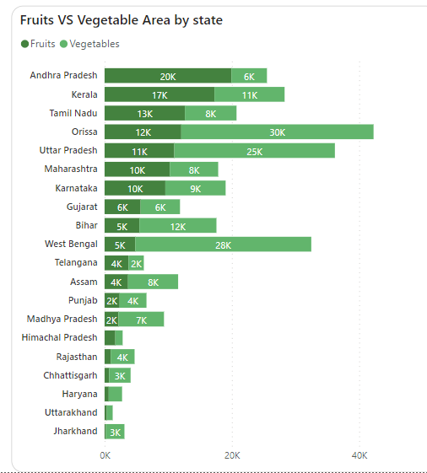
Fruits & Vegetables Analysis
Fruits & vegetables Area Distribution:
Top states like Orissa, Uttar Pradesh, and West Bengal
prioritize vegetable cultivation over fruits.
Conversely, Uttarakhand, Haryana, and Himachal Pradesh allocate minimal land to fruits and vegetables combined, suggesting opportunities for expansion in these areas.

Slide 18
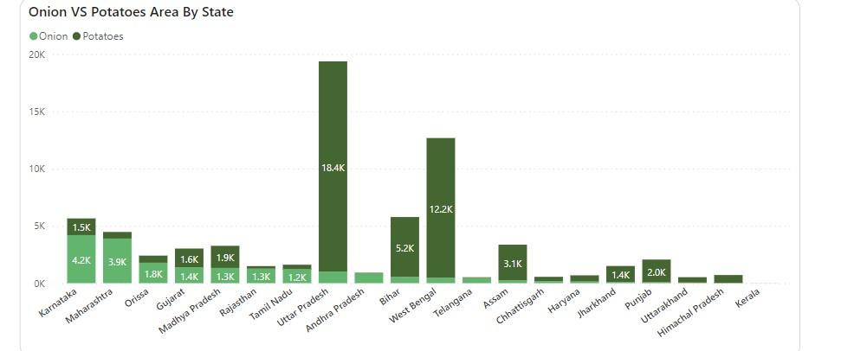
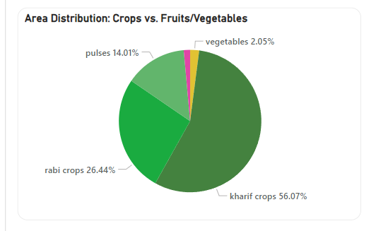
Fruits & Vegetables Analysis
Onion Vs Potatoes Area Distribution:
States like Uttar Pradesh and West Bengal predominantly allocate more land for potato cultivation compared to onions.
Karnataka stands out for onion cultivation, while Telangana, Kerala, and Uttarakhand allocate less land overall for both onions and potatoes.
Area Distribution: Crops vs Fruits/vegetables
Kharif crops occupy the majority of agricultural land, accounting for 56% of the total area, followed by 26% for rabi crops. Pulses cover 14% of the land, while vegetables and fruits combined constitute only about 3.5% of the total area.
This indicates a lesser focus on fruits and vegetables compared to staple crops like kharif and rabi varieties.

Slide 19
Recommendations
Diversify Crops: Encourage farmers to grow a variety of crops beyond staples like rice and wheat, focusing on high-
value options like fruits, vegetables, and pulses.
Adopt Modern Practices: Support farmers in using modern techniques like precision farming and drip irrigation to boost productivity and sustainability.
Improve Storage and Transport: Enhance post-harvest infrastructure to minimize wastage and ensure quality,
alongside strengthening market connections for better prices.
Offer Training Services: Provide farmers with training and extension services to learn about effective crop management and pest control methods.
Invest in Research: Allocate resources for agricultural research to develop resilient crop varieties and sustainable farming practices tailored to local conditions.
Encourage Organic Farming: Promote organic farming practices to meet growing consumer demand for chemical-free produce and improve soil health in the long term.
Enhance Market Access: Establish farmer producer organizations and strengthen market linkages to enable farmers to access wider markets and obtain fair prices for their produce.

Slide 20
Dashboard

Slide 21
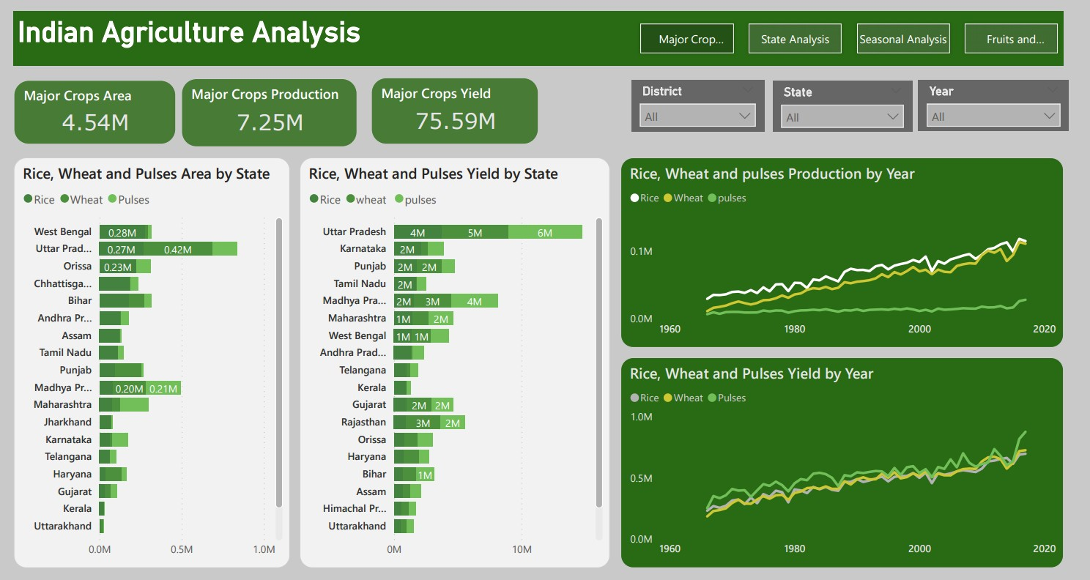

Slide 22
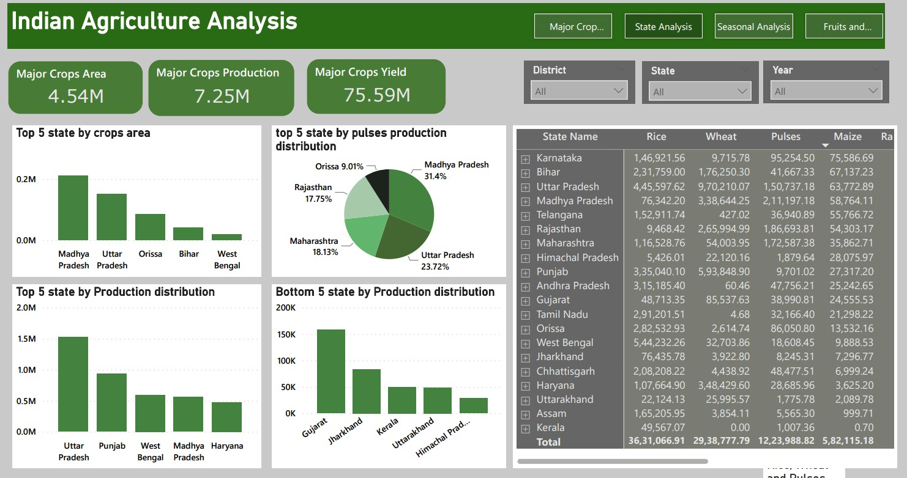

Slide 23
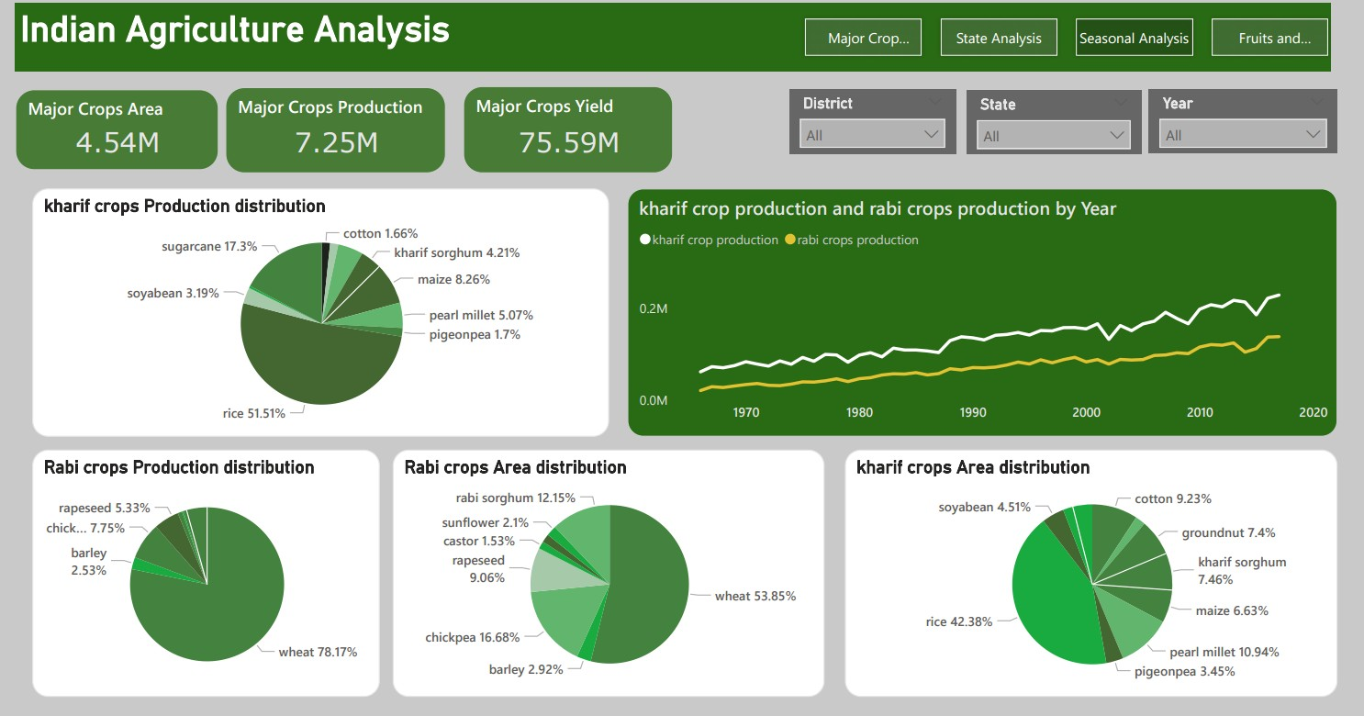

Slide 24
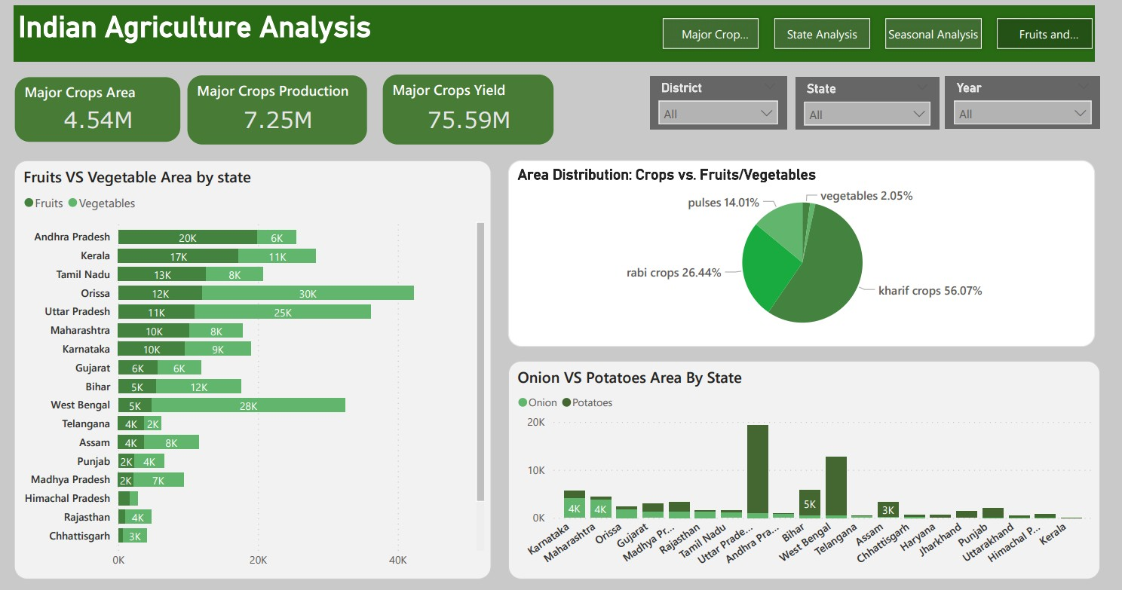

Slide 25

Thank You

